Slide 1

Futurense Technologies
Group 5
Akshay R
Bhuvana C
Neell Ravindra Ambere
Pratham Chopra

Slide 2
Index
Project Statement
Description
Code
Figures/Graph
Results(Screenshot)
Conclusion
References

Slide 3
Project Statement
Clean the Census Data:
Select and retain relevant columns for healthcare analysis.
Rename the Column Names:
Standardize column names for uniformity, considering the census year.
Rename State/UT Names:
Achieve uniformity in State/UT names for cohesive dataset representation.
New State/UT Formation:
Update state names post Telangana and Ladakh formations for historical accuracy.
Find and Process Missing Data:
Identify and fill missing data, visualize improvements before and after data filling.
Save Data:
Save processed data in "census.csv" for easy access in the "Clean_Data" folder.
Process Relevant Data from Housing Data:
Extract and calculate absolute values from housing data, save processed data in "housing.csv." Check for data consistency across datasets.

Slide 4
Description
1. Data Selection:
Identified essential columns, including population, literacy rates, and household details.
Utilized Pandas functions for efficient extraction and organization of relevant data.
2. Column Standardization:
Employed Pandas functions to standardize column names, ensuring clarity and uniformity.
Key libraries used: Pandas, NumPy for numerical operations.
3. State and Union Territory Uniformization:
Custom Python functions applied for consistent formatting of state and union territory names.
Considered exceptions like "and" for proper capitalization.
4. Geopolitical Changes Integration:
Custom Python functions updated state names post Telangana (2014) and Ladakh (2019) formations.

Slide 5
Description
5. Data Cleaning and Visualization:
Pandas functions used for filtering and organizing columns, retaining only essential information.
Matplotlib employed to create visualizations, comparing missing data percentages before and after the data-filling process.
6. Data Export:
Pandas functions utilized for exporting the refined census data, saved as "census.csv" for future healthcare analyses.
7. Housing Data Integration:
Functions employed for reading, processing, and seamlessly integrating housing data into the census dataset.

Slide 6
Code
Problem Statement 1: (Keep the relevant data) import pandas as pd
import matplotlib.pyplot as plt
import seaborn as sns
# Load the census data
census_data_relevant = pd.read_csv("/Users/bcr/Downloads/DS - Python + SQL + ETL - Healthcare Census (4)/DS - Python + SQL + ETL - Healthcare Census/Data/census_2011.csv")
census_data_relevant
# Select the relevant columns
census_data_relevant = census_data_relevant[["State name", "District name", "Population", "Male", "Female", "Literate", "Male_Literate", "Female_Literate", "Rural_Households", "Urban_Households", "Households","Age_Group_0_29", "Age_Group_30_49", "Age_Group_50", "Age not stated"]]
census_data_relevant

Slide 7
Code
Problem Statement 2: (Rename the Column names)
# Rename the column names
census_data_relevant = census_data_relevant.rename(columns={"State name": "State/UT", "District name": "District", "Male_Literate": "Literate_Male", "Female_Literate": "Literate_Female","Rural_Households": "Households_Rural", "Urban_Households": "Households_Urban", "Age_Group_0_29": "Young_and_Adult", "Age_Group_30_49": "Middle_Aged", "Age_Group_50": "Senior_Citizen", "Age not stated": "Age_Not_Stated"})
census_data_relevant

Slide 8
Code
Problem Statement 3: (Rename State/UT Names)
# Function to format state names
def format_state_name(state_name):
return " ".join(word.title() for word in state_name.split()).replace(" And ", " and ")
# Apply the function to the State/UT column
census_data_relevant["State/UT"] = census_data_relevant["State/UT"].apply(format_state_name)
census_data_relevant.to_csv("/Users/bcr/Downloads/DS - Python + SQL + ETL - Healthcare Census (4)/DS - Python + SQL + ETL - Healthcare Census/Data/clean data/census.csv", index=False)
census_data_relevant

Slide 9
Code
Problem Statement 4: (New State/UT formation)
telangana_districts_file = "/Users/bcr/Downloads/DS - Python + SQL + ETL - Healthcare Census (4)/DS - Python + SQL + ETL - Healthcare Census/Data/Telangana.txt"
with open(telangana_districts_file, 'r') as file:
telangana_districts = [line.strip() for line in file]
# Update State/UT for Telangana
census_data_relevant.loc[census_data_relevant['District'].isin(telangana_districts), 'State/UT'] = 'Telangana'
# Read Ladakh districts
ladakh_districts = ["Leh","Kargil","Leh(Ladakh)"]

Slide 10
Code
# Update State/UT for Ladakh
census_data_relevant.loc[census_data_relevant['District'].isin(ladakh_districts), 'State/UT'] = 'Ladakh'
# Save the updated DataFrame
census_data_relevant.to_csv("/Users/bcr/Downloads/DS - Python + SQL + ETL - Healthcare Census (4)/DS - Python + SQL + ETL - Healthcare Census/Data/clean data/cleandata.csv", index=False)
census_data_relevant

Slide 11
Code
Problem Statement 5: (Find and process Missing Data)
# Calculate percentage of missing data before filling
missing_percentage_before = pd.read_csv("/Users/bcr/Downloads/DS - Python + SQL + ETL - Healthcare Census (4)/DS - Python + SQL + ETL - Healthcare Census/Data/census_2011.csv").isnull().mean() * 100
# Fill missing values based on hints
census_data_relevant["Population"].fillna(census_data_relevant["Male"] + census_data_relevant["Female"], inplace=True)
census_data_relevant["Literate"].fillna(census_data_relevant["Literate_Male"] + census_data_relevant["Literate_Female"], inplace=True)
census_data_relevant["Population"].fillna(census_data_relevant["Young_and_Adult"] + census_data_relevant["Middle_Aged"] + census_data_relevant["Senior_Citizen"] + census_data_relevant["Age_Not_Stated"], inplace=True)
census_data_relevant["Households"].fillna(census_data_relevant["Households_Rural"] + census_data_relevant["Households_Urban"], inplace=True)

Slide 12
Code
# Calculate percentage of missing data after filling
missing_percentage_after = census_data_relevant.isnull().mean() * 100
# Visualization
fig, ax = plt.subplots(figsize=(10, 6))
sns.barplot(x=missing_percentage_before.index, y=missing_percentage_before, color='red', label='Before Filling')
sns.barplot(x=missing_percentage_after.index, y=missing_percentage_after, color='green', label='After Filling')
ax.set_ylabel('Percentage of Missing Data')
ax.set_title('Comparison of Missing Data Before and After Filling')
ax.legend()
plt.xticks(rotation=45, ha='right')
plt.tight_layout()
plt.show()

Slide 13
Code
Problem Statement 6: (Save Data)
census_data_relevant.to_csv("/Users/bcr/Downloads/DS - Python + SQL + ETL - Healthcare Census (4)/DS - Python + SQL + ETL - Healthcare Census/Data/clean data/census.csv", index=False)
census_data_relevant

Slide 14
Code
Problem Statement 7: (Process the relevant data)
# Read housing data
housing_data = pd.read_csv("/Users/bcr/Downloads/DS - Python + SQL + ETL - Healthcare Census (4)/DS - Python + SQL + ETL - Healthcare Census/Data/housing.csv")
# Read census data
census_data = pd.read_csv("/Users/bcr/Downloads/DS - Python + SQL + ETL - Healthcare Census (4)/DS - Python + SQL + ETL - Healthcare Census/Data/clean data/census.csv")
housing_data # Function to format state names
def format_state_name(state_name):
return " ".join(word.title() for word in state_name.split()).replace(" And ", " and ")

Slide 15
Code
# Apply the function to the State/UT column
housing_data["State Name"] = housing_data["State Name"].apply(format_state_name)
housing_data.to_csv("/Users/bcr/Downloads/DS - Python + SQL + ETL - Healthcare Census (4)/DS - Python + SQL + ETL - Healthcare Census/Data/housing.csv", index=False)
housing_data
# Merge housing and census data on District Name
merged_data = pd.merge(housing_data, census_data, left_on='District Name', right_on='District', how='outer')

Slide 16
Code
# Calculate absolute values for relevant columns
merged_data['Households_Rural'] = merged_data['Total Number of households'] * merged_data['Households_Rural'] / 100
merged_data['Households_Urban'] = merged_data['Total Number of households'] * merged_data['Households_Urban'] / 100
merged_data['Households_Rural_Livable'] = merged_data['Households_Rural'] * merged_data['Total Number of Livable'] / 100
merged_data['Households_Urban_Livable'] = merged_data['Households_Urban'] * merged_data['Total Number of Livable'] / 100
merged_data['Households_Rural_Dilapidated'] = merged_data['Households_Rural'] * merged_data['Total Number of Dilapidated'] / 100
merged_data['Households_Urban_Dilapidated'] = merged_data['Households_Urban'] * merged_data['Total Number of Dilapidated'] / 100
merged_data['Households_Rural_Toilet_Premise'] = merged_data['Households_Rural'] * merged_data['Latrine_premise'] / 100

Slide 17
Code
merged_data['Households_Urban_Toilet_Premise'] = merged_data['Households_Urban'] * merged_data['Latrine_premise'] / 100
# Save the processed data
housing_data_merged="/Users/bcr/Downloads/DS - Python + SQL + ETL - Healthcare Census (4)/DS - Python + SQL + ETL - Healthcare Census/Data/clean data/housing.csv"
merged_data.to_csv(housing_data_merged, index=False)
# Report if any district data is in one file but not the other
missing_districts_census = census_data[~census_data['District'].isin(housing_data['District Name'])]['District']
missing_districts_housing = housing_data[~housing_data['District Name'].isin(census_data['District'])]['District Name']
print("Districts in census but not in housing data: \n ", missing_districts_census.tolist())
print("\n Districts in housing but not in census data: \n ", missing_districts_housing.tolist())

Slide 18
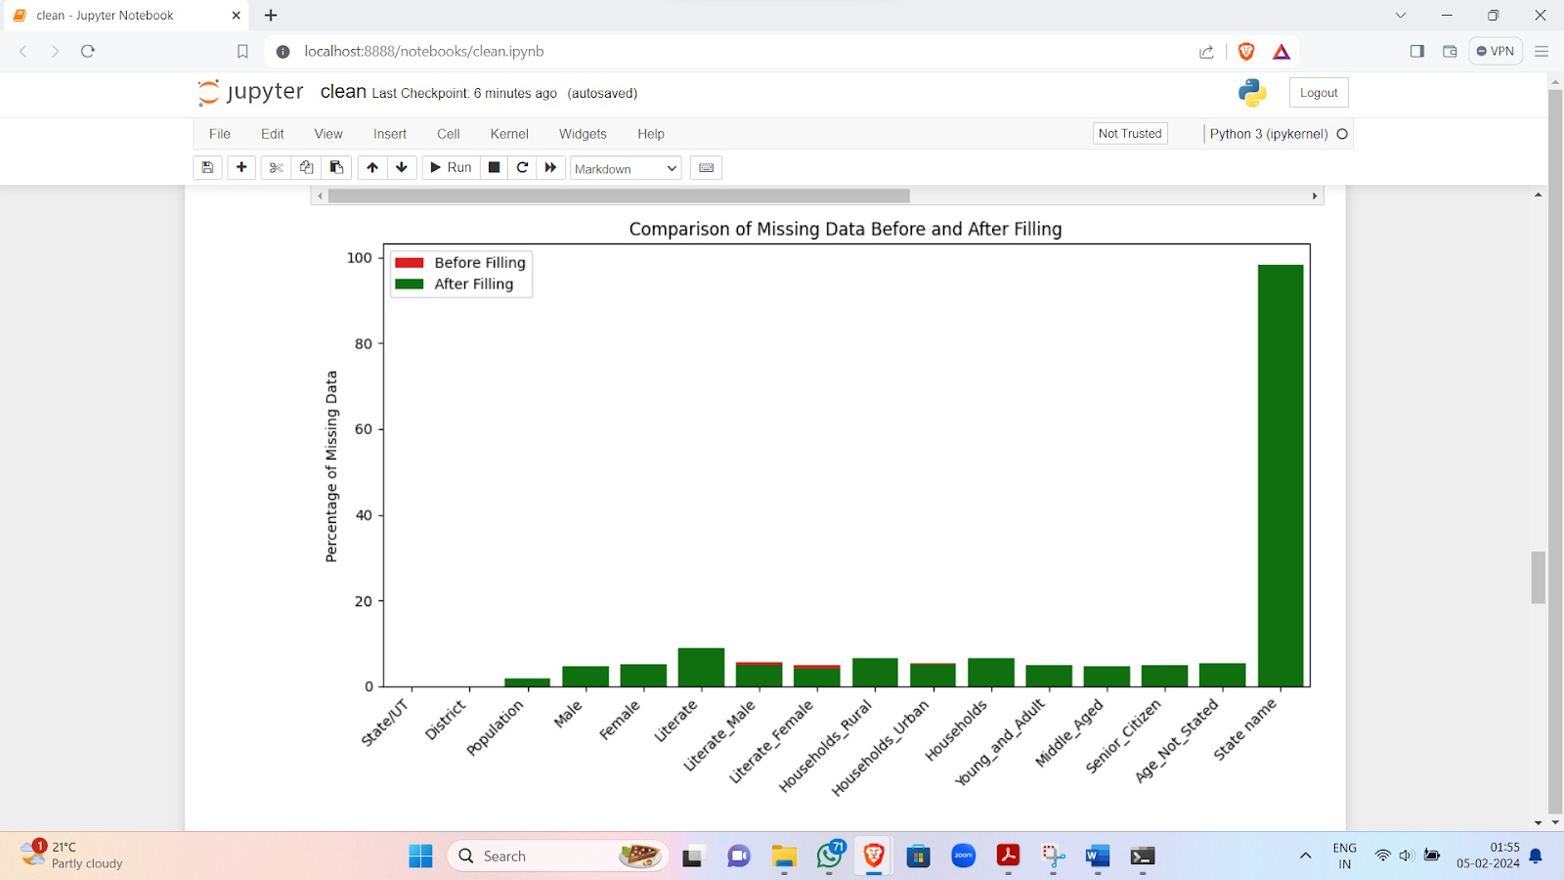
Figures/Graph

Slide 19
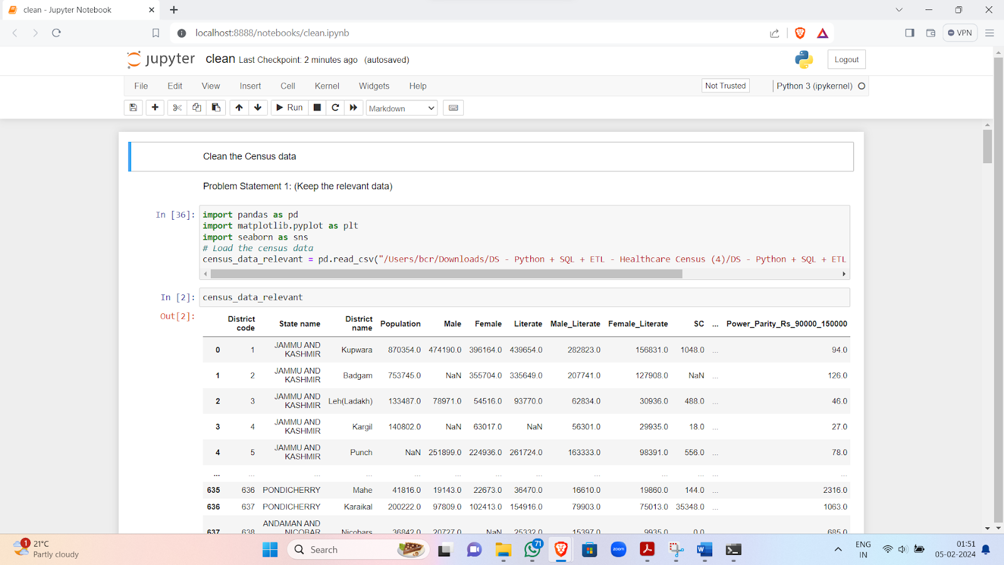
Results(Screenshot)
Image 1 : Problem Statement - Keeping The Relevant Data

Slide 20
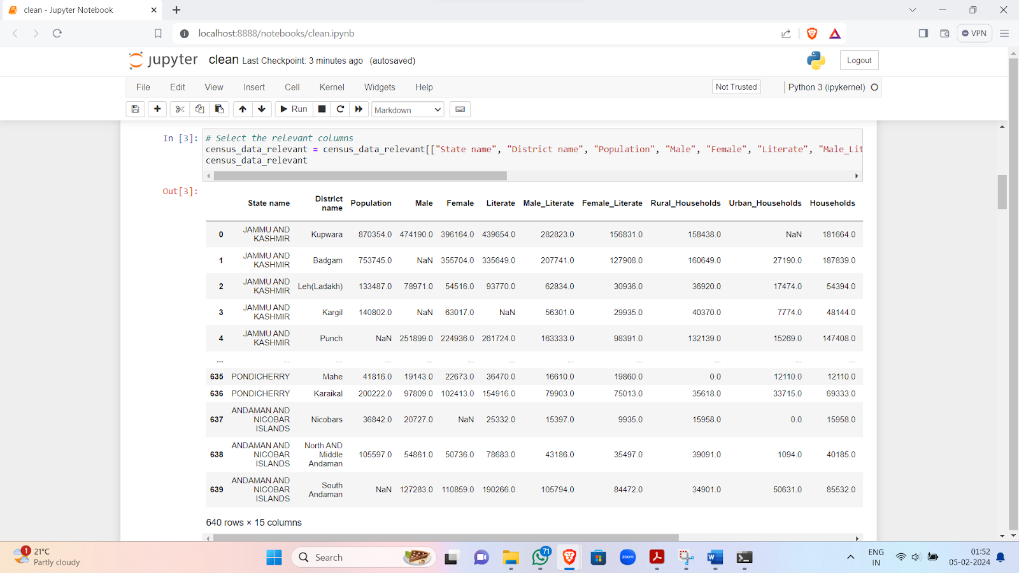
Results(Screenshot)
Image 2 : Problem Statement 1 - Contd.

Slide 21
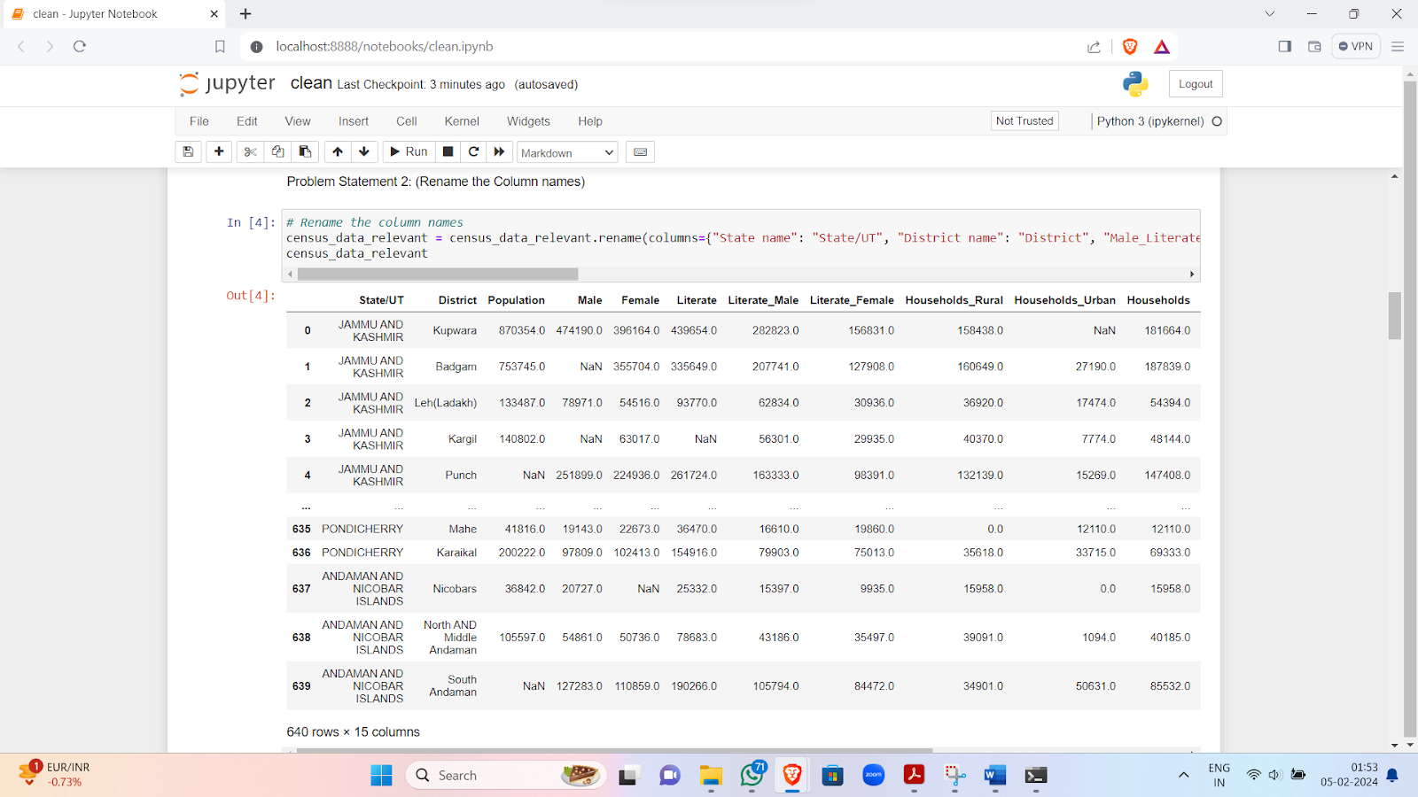
Results(Screenshot)
Image 3 : Problem Statement 2 - Rename The Column Names

Slide 22
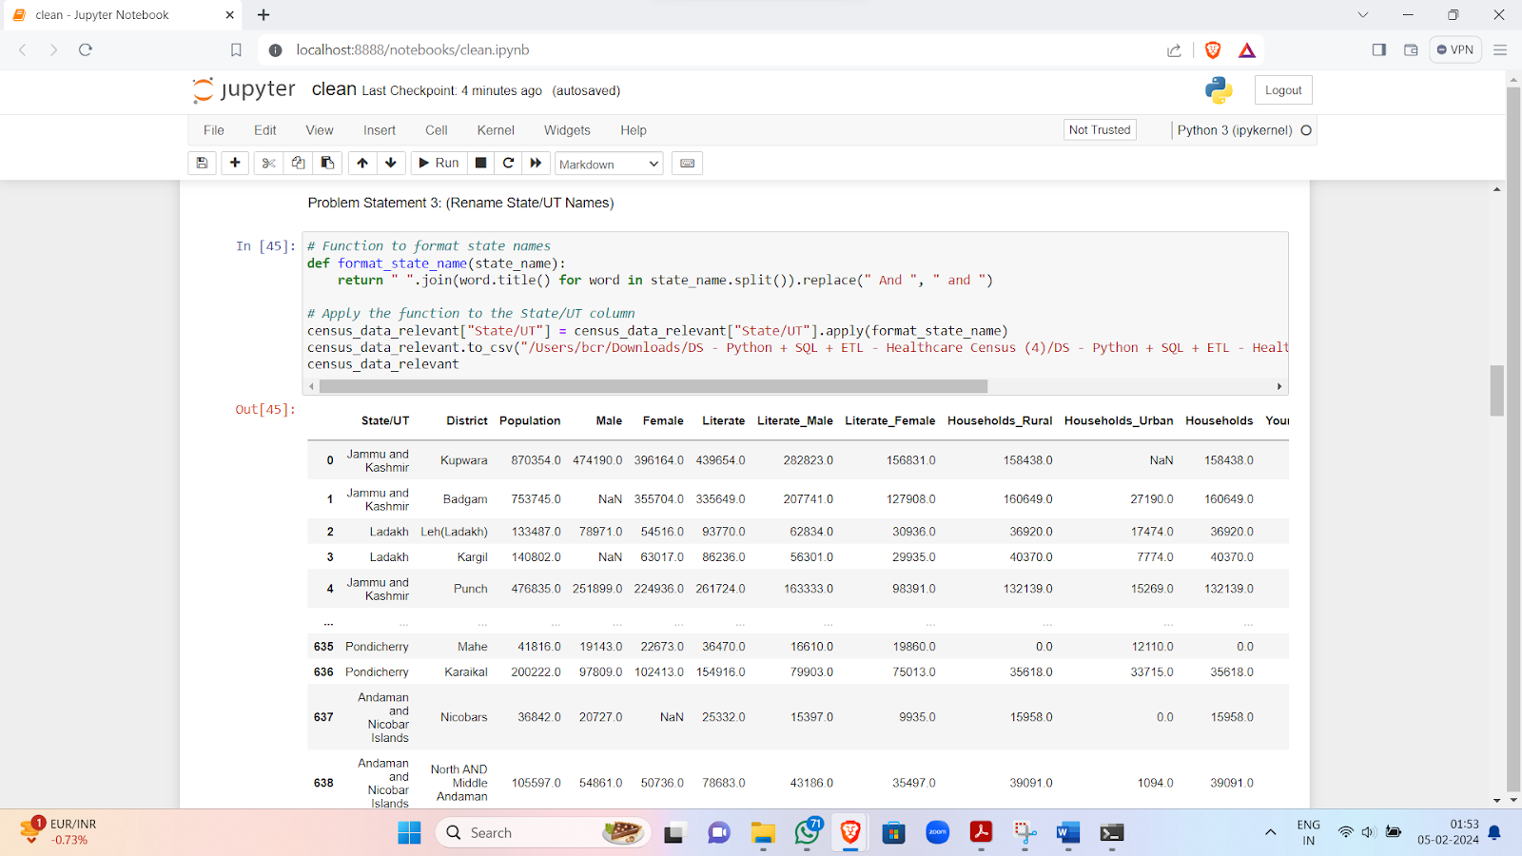
Results(Screenshot)
Image 4 : Problem Statement - Rename State / UT Names

Slide 23
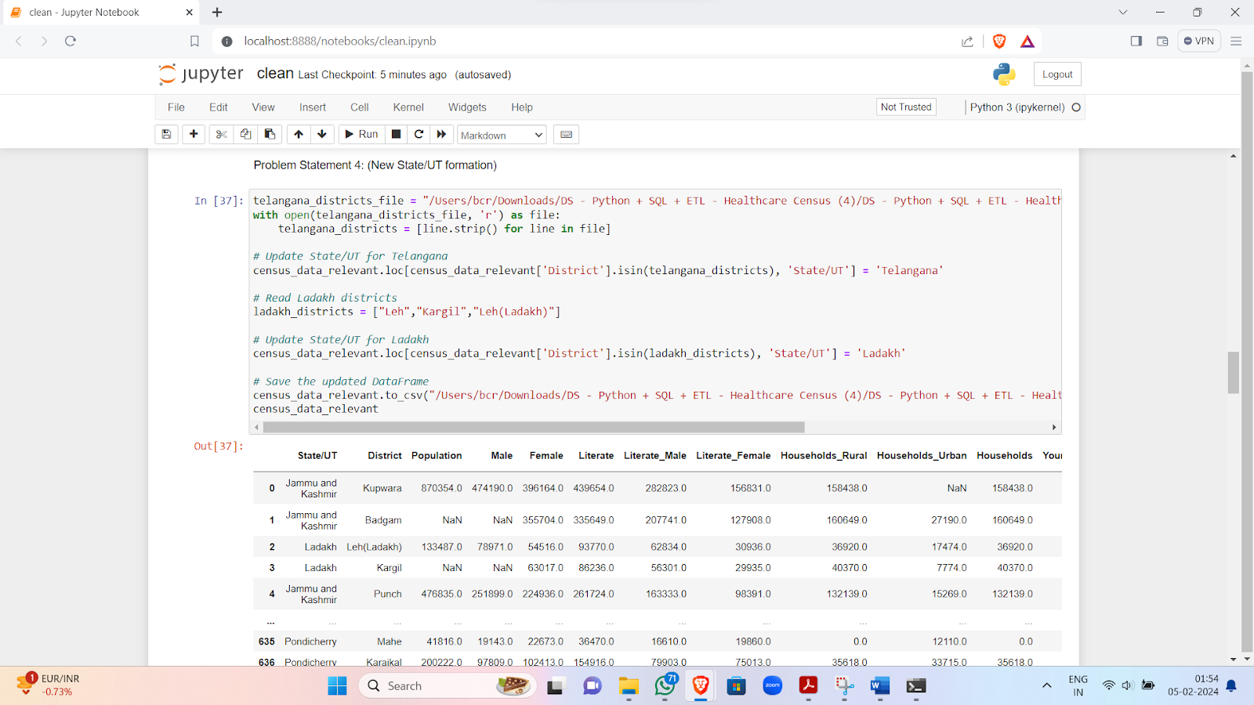
Results(Screenshot)
Image 5 : Problem Statement - New State / UT Formation

Slide 24
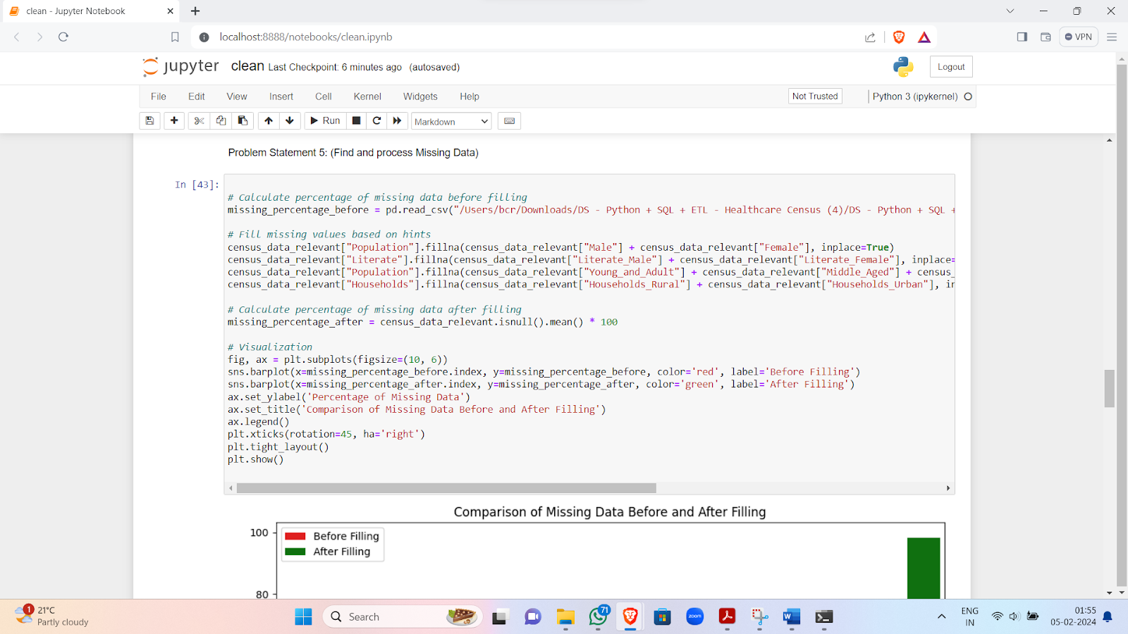
Results(Screenshot)
Image 6 : Problem Statement 5 - Find & Process Missing Data

Slide 25
Results(Screenshot)
Image 7 : Graph - Comparison Of Missing Data Before & After Filling

Slide 26
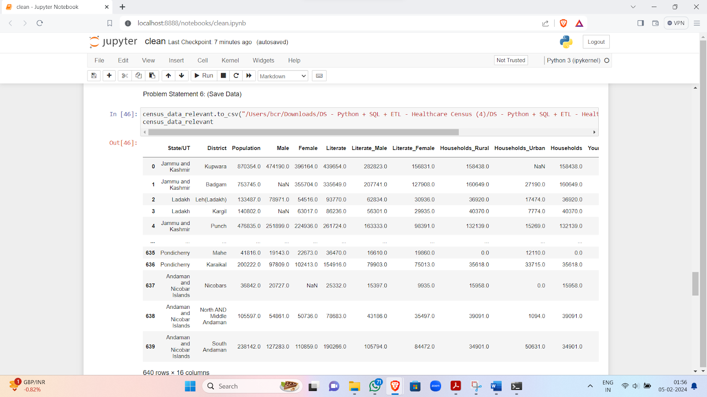
Results(Screenshot)
Image 8 : Problem Statement 6 - Save Data

Slide 27
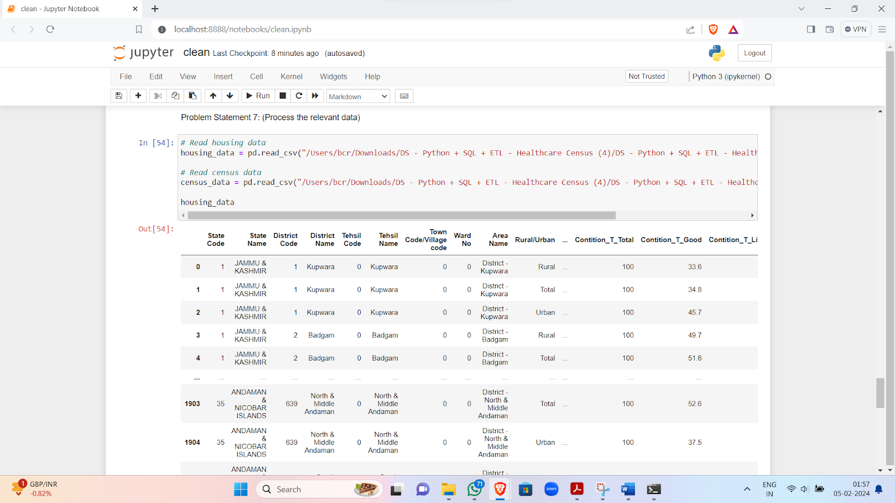
Results(Screenshot)
Image 9 : Problem Statement 7 - Process The Relevant Data

Slide 28
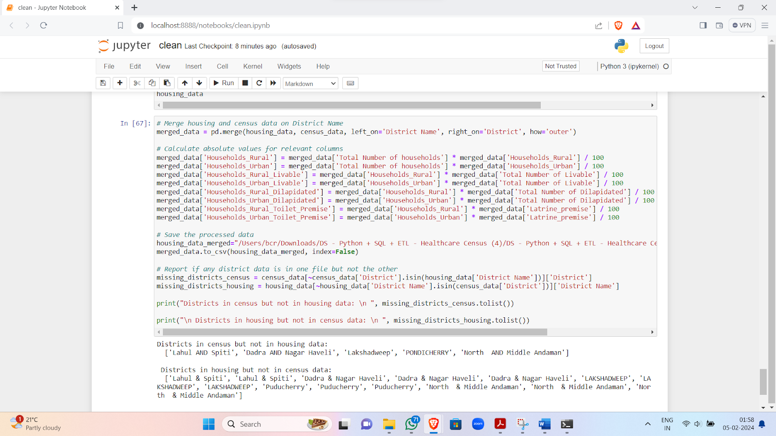
Results(Screenshot)
Image 10 : Problem Statement 7 - Contd.

Slide 29
Conclusion
1. Refining the Data:
We worked on refining the dataset, focusing on essential aspects like population, literacy rates, and household details.
2. Consistent Naming:
Successfully made the dataset more organized by standardizing column and state/union territory names.
3. Handling Changes:
Integrated changes from Telangana (2014) and Ladakh (2019) formations seamlessly.
4. Complete Data Set:
Addressed missing values, resulting in a much more complete dataset for thorough healthcare analysis.
5. Visual Insight:
Created visuals comparing missing data percentages, providing a clear before-and-after view.
6. Easy Accessibility:
Saved the refined census data as "census.csv," making it easily accessible for future healthcare analyses.
7. Holistic Foundation:
Extended our analysis to housing data, enriching the dataset for comprehensive healthcare research.
8. Project Conclusion:
Successfully achieved our goals, creating a clean, standardized dataset ready for valuable insights in healthcare research.

Slide 30
References
Pandas Documentation. (n.d.). Retrieved from https://pandas.pydata.org/pandas-docs/stable/index.html
Matplotlib Documentation. (n.d.). Retrieved from https://matplotlib.org/stable/contents.html
NumPy Documentation. (n.d.). Retrieved from https://numpy.org/doc/stable/
OpenAI Generative Pre-Trained Model - 3.5. (n.d.). Retrieved from https://chat.openai.com/
Google Bard AI Experiment. (n.d.). Retrieved from https://bard.google.com/chat
Jupyter Notebook Documentation. (n.d.). Retrieved from https://jupyter.org/documentation
Stack Overflow Community. (n.d.). Retrieved from https://stackoverflow.com/
GeeksforGeeks. (n.d.). Retrieved from https://www.geeksforgeeks.org/
Data Cleaning and Preprocessing with Python. (n.d.). Retrieved from https://towardsdatascience.com/data-cleaning-with-python-and-pandas-detecting-missing-values-3e9c6ebcf78b

Slide 31
Thank You!!!

